Slide 1

Principal Component Analysis (PCA)

Slide 2
Introduction
It is unsupervised machine learning technique
Principal Component Analysis (PCA) is a linear dimensionality reduction technique
it simplifies the complexity of the data by transforming it into a lower dimensional space while retaining most of the information
It is used when the number of features is large
It can be used for various applications such as image processing, speech recognition, and data compression

Slide 3
The main idea behind PCA is to find a new set of variables, called principal components
principal components linear combinations of the original features
These principal components are chosen in such a way that they explain the maximum amount of variance in the data.

Slide 4
Dimensions are nothing but features that represent the data.
Example:
A 28 X 28 image has 784 picture elements (pixels) that are the dimensions or features which together represent that image.
In iris dataset we have 4 features
The company has collected data on various customer attributes such as age, income, browsing time, products purchased, etc.

Slide 5
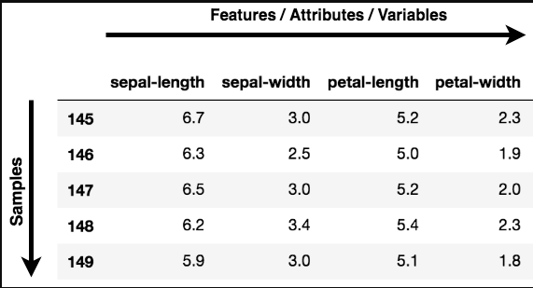

Slide 6
Why use PCA?
Data Visualization
It projects the data into a lower dimension, allowing you to visualize the data in a 2D or 3D space
Speeding Up a Machine Learning (ML) Algorithm
As the features are reduced it becomes easier to train

Slide 7
Thank You

